Slide 1
Date: 13 Feb 2018, Update 09 July 2018
Instrument Setups at V20 to be used for ‘Instrument definition files’
Diffraction
2 configurations of 3He tubes
V20_4-tubes_90deg_Definition_v01.xml
V20_4-tubes_150deg_Definition_v01.xml
Can you please ensure that both files are according to the drawings on the next slides?
The DENEX setup will be requested later
Transmisison/Imaging
Beam monitor used as transmission detector
V20_BM_Transm_Definition_v01.xml
V20_MCP_512x512_Transm_Definition_v01.xml
The transmission (imaging) setups will also be defined in this way soon!

Slide 2
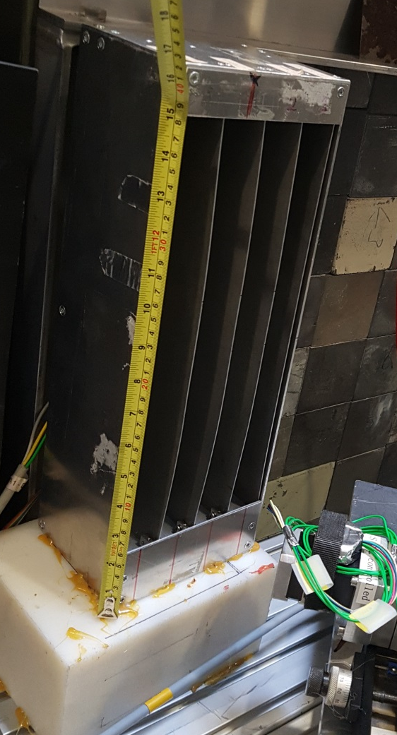
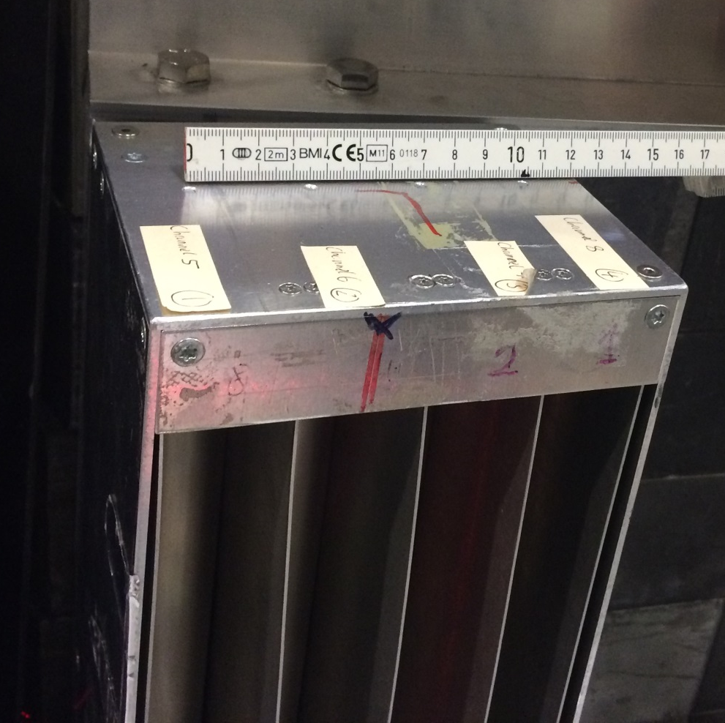
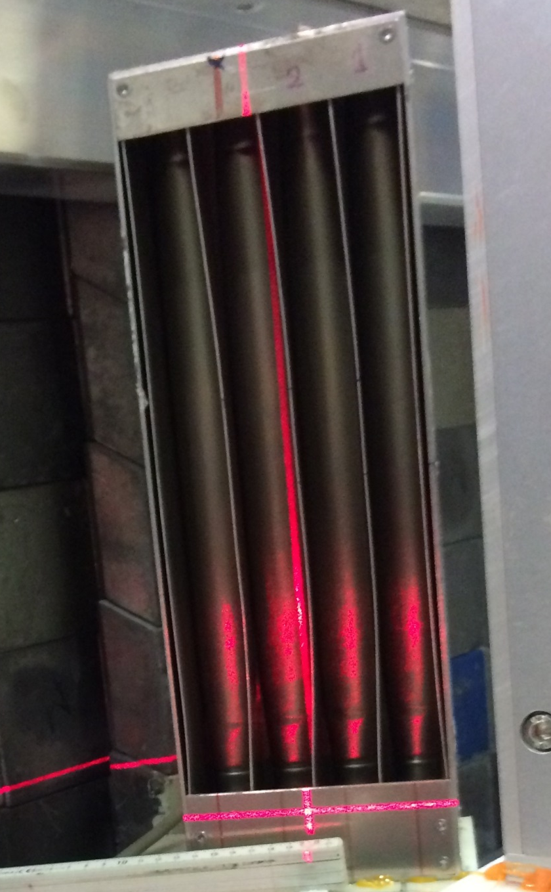
He detector geometry
320mm
Unfortuntaley I do not have the height of the detector element with respect to the beam.
Let us assume center for now
35mm
35mm
35mm
5
6
7
8
D=25.4mm

Slide 3
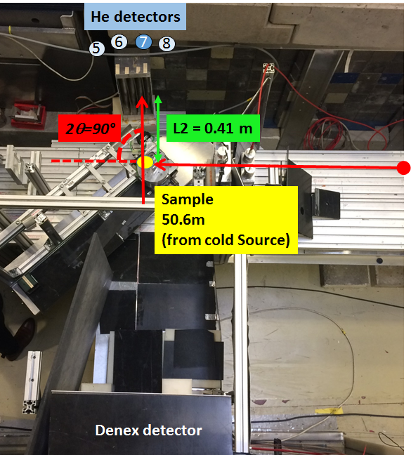
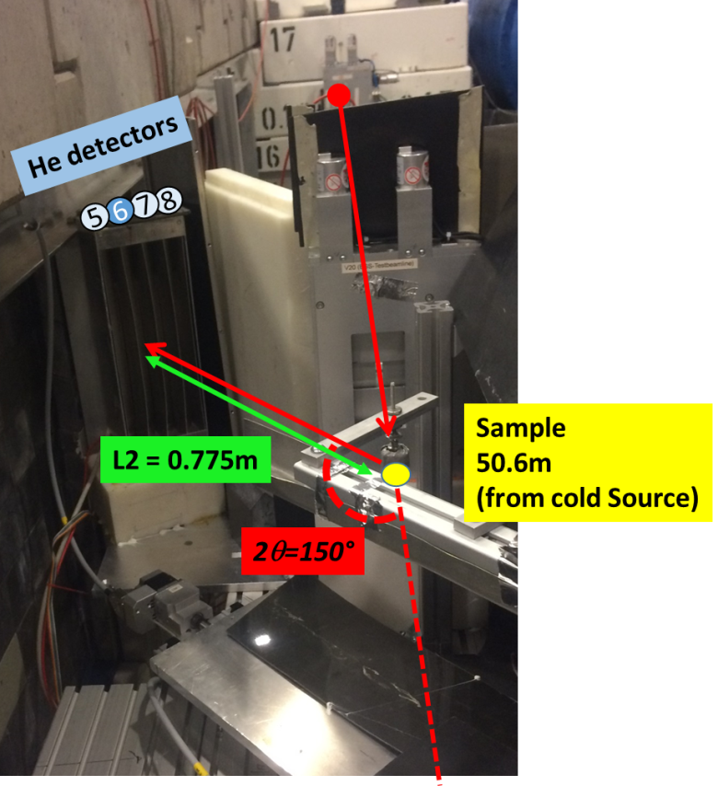
V20_4-tubes_150deg_Definition
Sample
L1=50.6m
(from cold Source)
n
Sample in V can
Source
2θ=90°
S#2
S#3
L2 = 0.41m
He detectors
8
7
6
5
V20_4-tubes_150deg_Definition
Sample
L1=50.6m
(from cold Source)
n
Sample in V can
Source
S#3
S#2
2θ=150°
He detectors
8
7
6
5
L2 = 0.775m

Slide 4
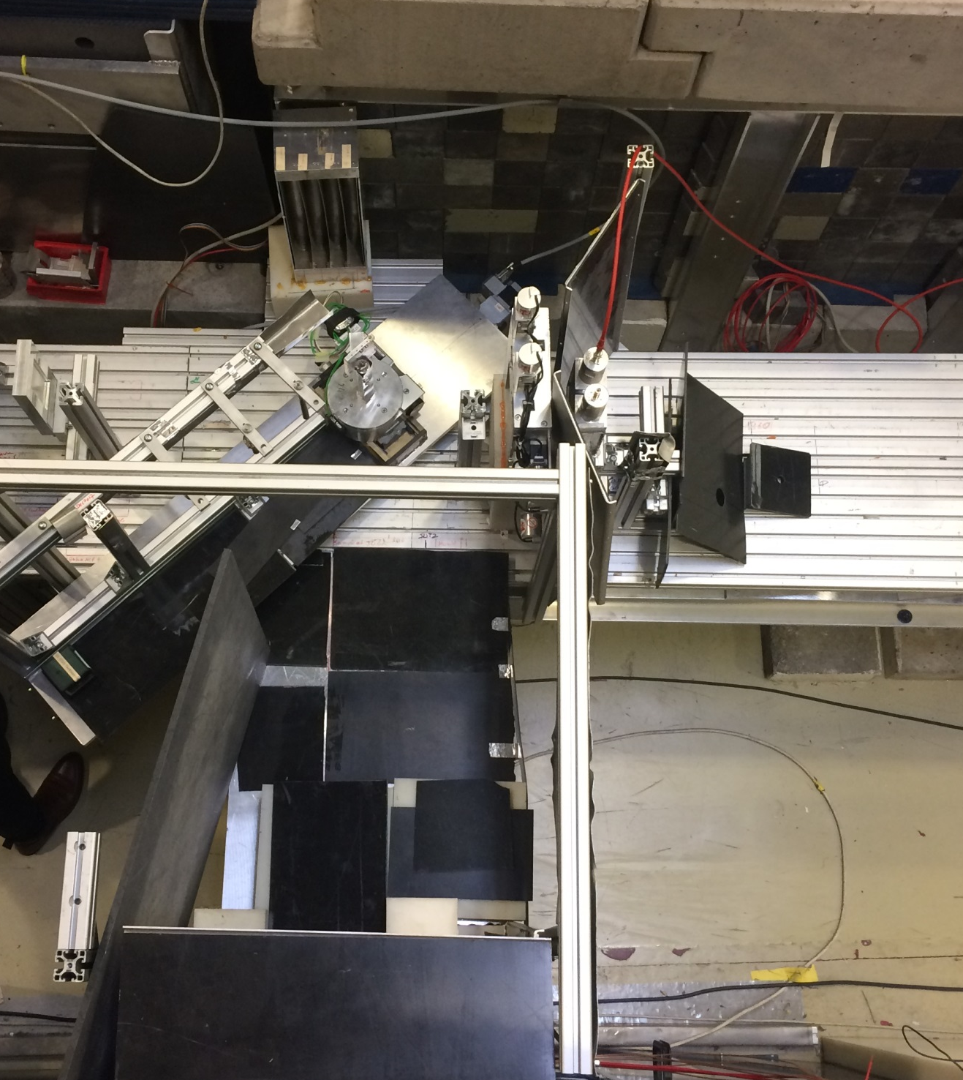
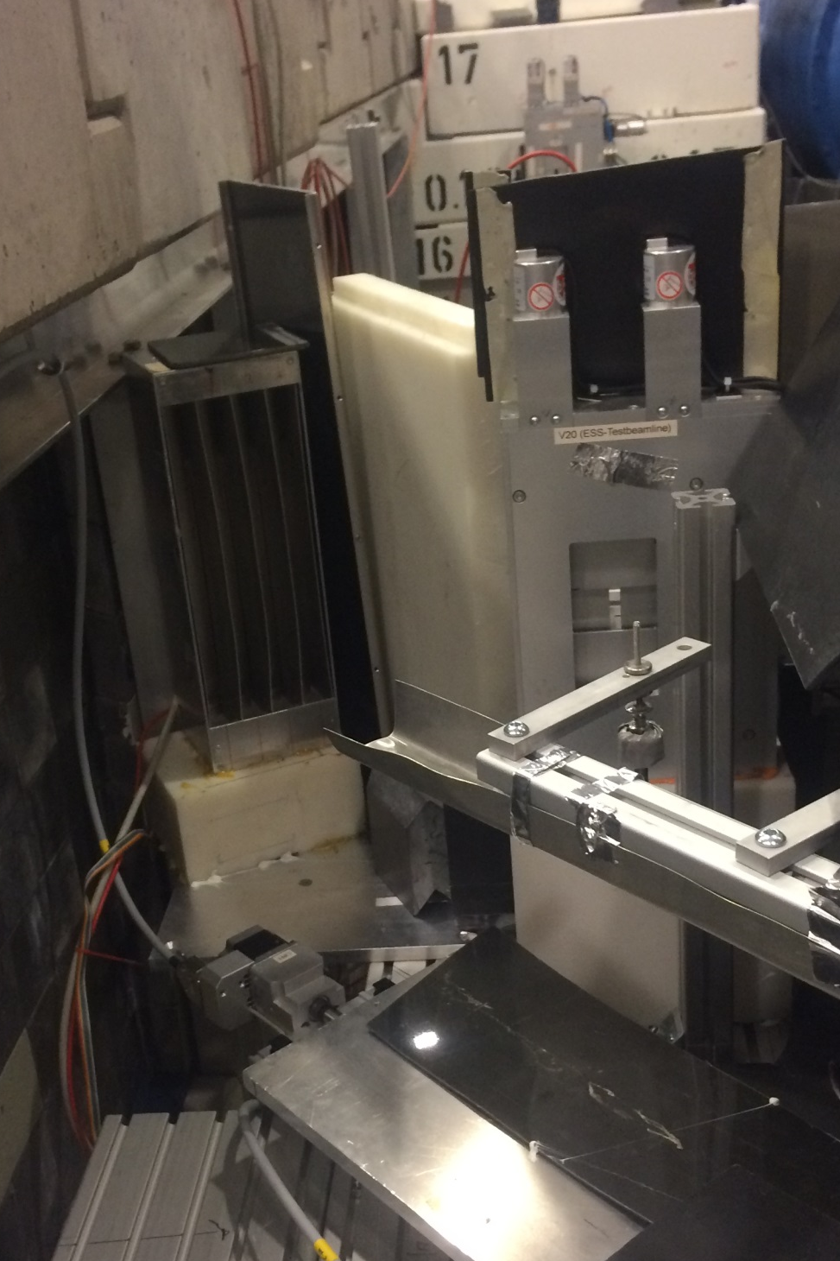
V20_4-tubes_150deg_Definition
V20_4-tubes_150deg_Definition
He detectors
5
6
7
8
He detectors
2θ=90°
L2 = 0.41 m
5
6
7
8
Sample
50.6m
(from cold Source)
Sample
50.6m
(from cold Source)
L2 = 0.775m
2θ=150°
Denex detector

Slide 5
Denex detector
L2’
L1
n
Sample in V can
Source
2θ=90°
S#1
S#2
L2
Total time of flight distance L = L1 +L2
He detectors
DIFC=252.816 * 2* L * Sinθ
8
7
6
5
Denex detector
L2’
L1
2θ=90°
n
Sample in V can
Source
S#2
S#1
2θ=150°
Total time of flight distance L = L1 +L2
He detectors
8
7
6
5
L2
DIFC=252.816 * 2* L * Sinθ

Slide 6
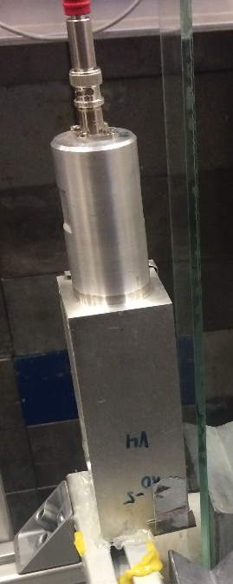
V20_BM_Transm_Definition_v01.xml
Dimensions of Beam Monitor
Active Window:
Width: 40mm
Height: 105mm
Depth 40mm
Sample
L1 = X m
(from cold Source)
L2
n
Source
S#1
S#2
1 channel
Beam monitor used as detector
The position of sample (L1) and beam monitor (L2) should be adjustable (easily as input parameter)
We use any position from L1=47.2m up to L1=55m
Question: Should we define L2 as center of beam monitor or at front?
Slit 2 and Slit 3 are adjustable and are changed. Are these even in the IDF?
Note: In a similar way, we also use imaging cameras (for example 512x512 pixels with 55um pixel size as we defined before). See separate IDF request

Slide 7
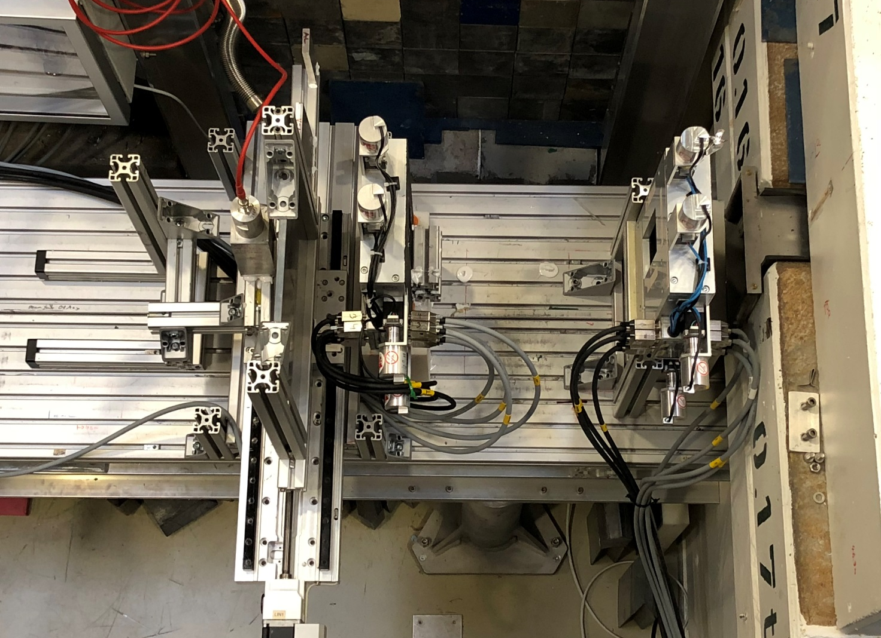
V20_BM_Transm_Definition_v01.xml
Sample
L1=Xm
(from cold Source)
Sample
n
Slit #3
Slit #2
Source
1 channel
Beam monitor used as detector

Slide 8
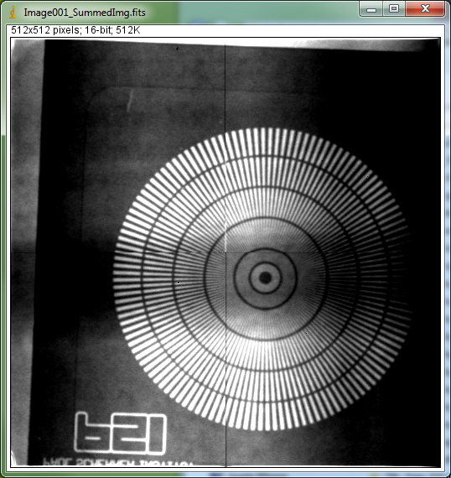
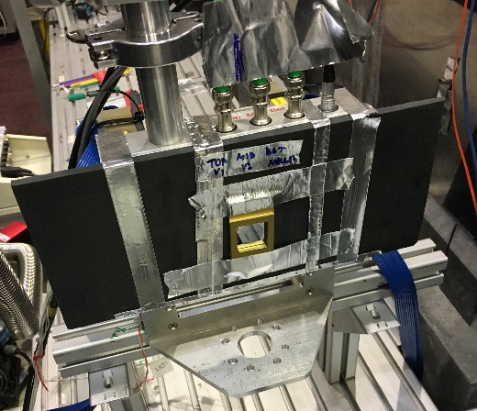
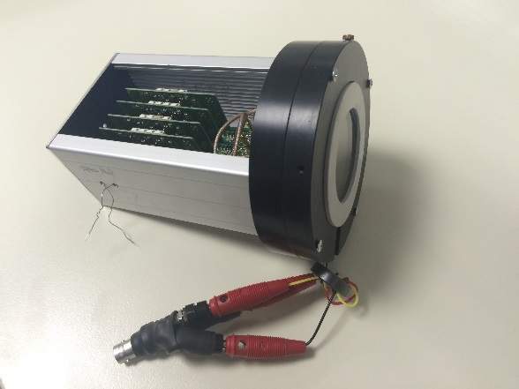
V20_MCP_512x512_Transm_Definition_v01.xml
Dimensions of MCP detector
Pixel size: 55um
Pixel X: 512, Pixel Y: 512
Pixel ID’s: from top left
Sample
L1 = X m
(from cold Source)
L2
n
0
x
Source
S#1
S#2
512 x 512 pixel
TOF Imaging camera
y
The position of sample (L1) and beam monitor (L2) should be adjustable (easily as input parameter)
Will soon define all the imaging detectors. We use 3 different types so far.
V20_MCP_512x512_Transm_Definition_v01.xml

